Slide 1


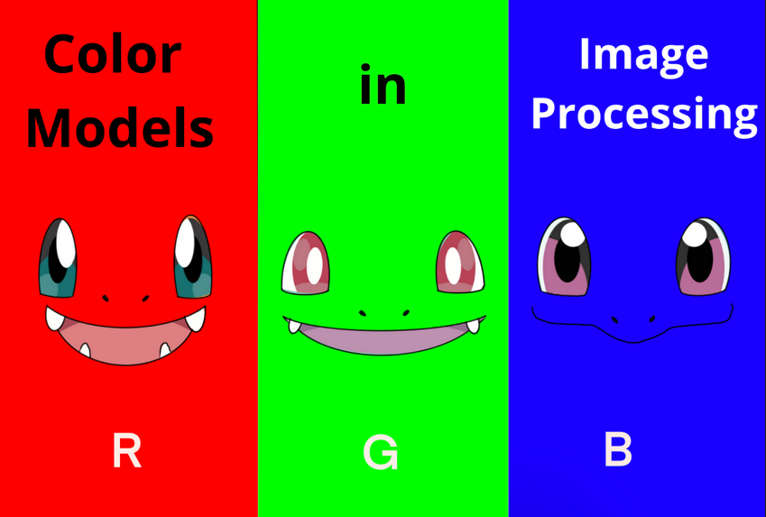
Session 4 :
Understanding Color Models

Slide 2
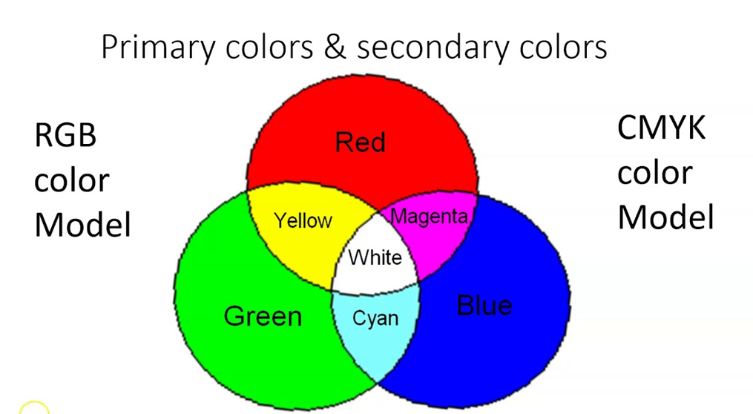
What is a Color Model?
A color model is a system that represents colors using numbers.
It helps computers, TVs, and printers display and process colors correctly.
A color model is an abstract mathematical model that describes how colors can be represented as a set of numbers (e.g., a triple in RGB or a quad in CMYK). Color models can usually be described using a coordinate system, and each color in the system is represented by a single point in the coordinate space.

Slide 3
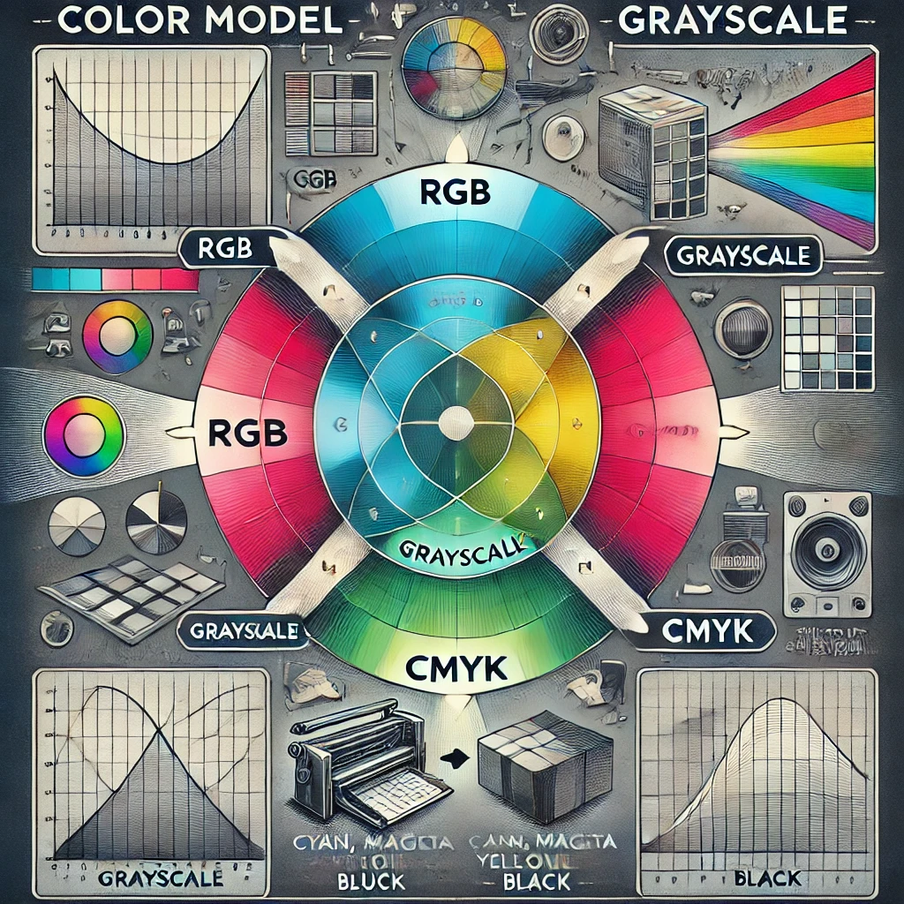
Why is it Important?
Used in computer graphics, photography, printing, and video production.
Helps in designing images, animations, and games.
Used in medical imaging (X-rays, MRI scans) and AI-based image recognition.
Image Suggestion:

Slide 4
Types of Color Models
1. RGB (Red, Green, Blue) – Additive Color Model
Used in: Digital screens (TVs, monitors, smartphones)
Colors are created by adding different intensities of Red, Green, and Blue light.
White = Full intensity of all three colors (255,255,255)
Black = No light (0,0,0)
Why is it important?
Used in computer graphics, digital images, and web design.
The standard color model for cameras, TVs, and smartphones.

Slide 5

2. CMYK (Cyan, Magenta, Yellow, Black) – Subtractive Color Model
Used in: Printing (Magazines, newspapers, posters, flyers)
CMYK works by absorbing light; colors are created by subtracting light reflected from a white surface.
Black (K) is added to enhance contrast.
Why is it important?
Used in printers for high-quality color reproduction.
More accurate for printed images than RGB
3. Grayscale – Black & White Image Representation
Used in: Medical imaging (X-rays, MRI scans), old photography, document scanning
Represents images in shades of gray (0 = black, 255 = white).
No color information, only brightness levels.
Why is it important?
Reduces file size (used in AI and image processing).
Helps in medical and security imaging.

Slide 6
4. HSV (Hue, Saturation, Value) – Perceptual Color Model
Used in: Image editing, graphics design, animation
Hue: The type of color (red, blue, green, etc.).
Saturation: Intensity of the color (high = bright, low = faded).
Value (Brightness): How dark or light the color appears.
Why is it important?
Helps in color filtering, AI-based object recognition, and artistic design.
5. YUV (YCbCr) – Used in Video Processing & Broadcasting
Used in: TV broadcasting, video compression (MP4, JPEG)
Y = Luminance (Brightness information)
U and V (CbCr) = Chrominance (Color information)
Separates brightness and color, making it efficient for video compression.
Why is it important?
Reduces storage space for videos , Used in streaming, DVDs, and broadcasting.

Slide 7
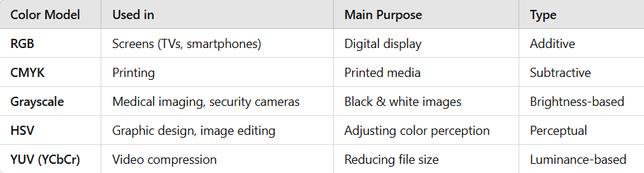
Comparison Table: RGB vs. CMYK vs. Grayscale vs. HSV vs. YUV

Slide 8
Python Code using OpenCV and Matplotlib to convert a color image to grayscale and visualize the individual color channels (Red, Green, Blue) separately.
import cv2
import matplotlib.pyplot as plt
# Load the image in color
image = cv2.imread('your_image.jpg') # Replace with your image path
# Convert BGR (OpenCV default) to RGB for Matplotlib display
image_rgb = cv2.cvtColor(image, cv2.COLOR_BGR2RGB)
# Convert to grayscale
gray_image = cv2.cvtColor(image, cv2.COLOR_BGR2GRAY)
# Split the channels (Note: OpenCV uses BGR, so order is Blue, Green, Red)
blue_channel, green_channel, red_channel = cv2.split(image)
# Plotting the results
plt.figure(figsize=(12, 8))

Slide 9
# Original RGB Image
plt.subplot(2, 3, 1)
plt.imshow(image_rgb)
plt.title('Original Image (RGB)')
plt.axis('off')
# Grayscale Image
plt.subplot(2, 3, 2)
plt.imshow(gray_image, cmap='gray')
plt.title('Grayscale Image')
plt.axis('off')
# Red Channel
plt.subplot(2, 3, 4)
plt.imshow(red_channel, cmap='Reds')
plt.title('Red Channel')
plt.axis('off')

Slide 10
# Green Channel
plt.subplot(2, 3, 5)
plt.imshow(green_channel, cmap='Greens')
plt.title('Green Channel')
plt.axis('off')
# Blue Channel
plt.subplot(2, 3, 6)
plt.imshow(blue_channel, cmap='Blues')
plt.title('Blue Channel')
plt.axis('off')
plt.tight_layout()
plt.show()

Slide 11
Fun Facts!
Did You Know?
The human eye can detect about 10 million colors, but only around 30 shades of gray.
Most old movies were filmed in grayscale before color cameras became common.
RGB is the most widely used color model for digital images.
Medical images are often in grayscale to highlight important details clearly.

Slide 12
Exercise
1. What does RGB stand for?
A) Red, Green, Black B) Red, Gray, Blue C) Red, Green, Blue D) Red, Gold, Brown
Answer: C) Red, Green, Blue
2. Which color model is used in TV screens?
A) CMYK B) Grayscale C) HSV D) RGB
Answer: D) RGB

Slide 13
Exercise
3. How many shades does grayscale have?
A) 10 B) 100 C) 256 D) 1024 Answer: C) 256
4. Why is grayscale used in medical images?
A) It looks colorful B) It helps doctors see details clearly C) It’s easier to print D) It saves ink Answer: B) It helps doctors see details clearly

Slide 14
Exercise
6. In the HSV color model, what does the 'S' stand for?
A) Spectrum B) Sharpness C) Saturation D) Softness
Answer: C) Saturation

